Slide 1
Tsinghua University Economic History and Development in Latin America Instructor: Prof. Lucas Llach (affiliation: Universidad Torcuato Di Tella, Argentina) Lecture 1/8. Introduction

Slide 2
Our Lecture Series
Phases of development in Latin America
Chronological order
"Old" economic history?
Why Economic History and Development
Not exactly a success, but some partial successes, and you also learn from failures.
History never repeats iself, but it rhymes

Slide 3
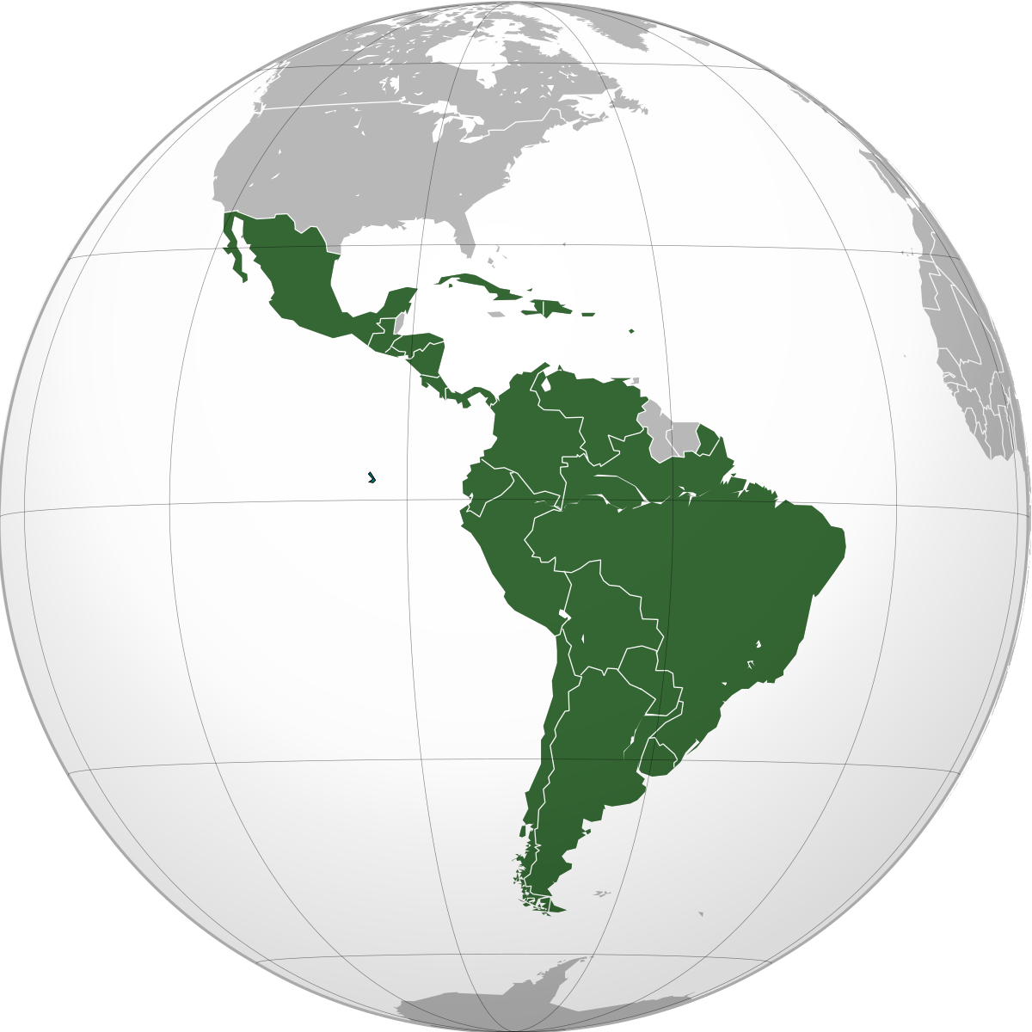
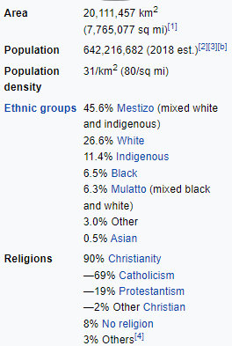
What We Talk About When We Talk About LatAm

Slide 4
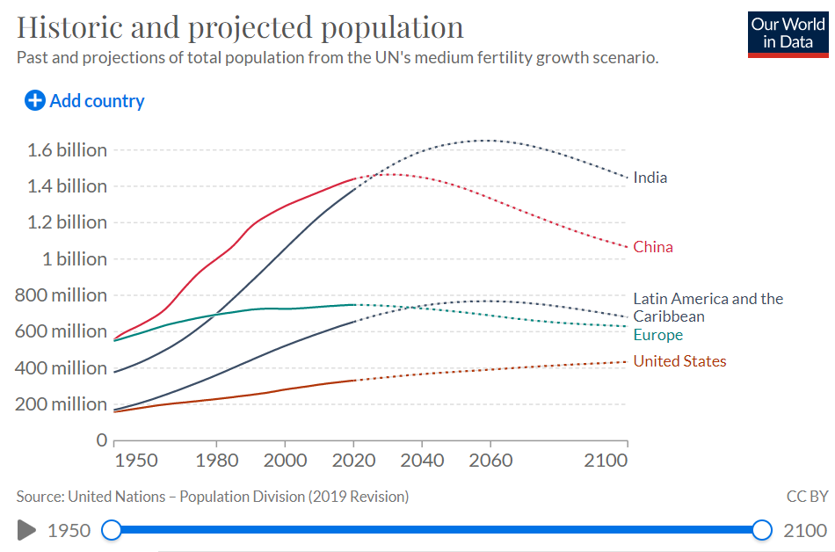
What We Talk About When We Talk About LatAm

Slide 5
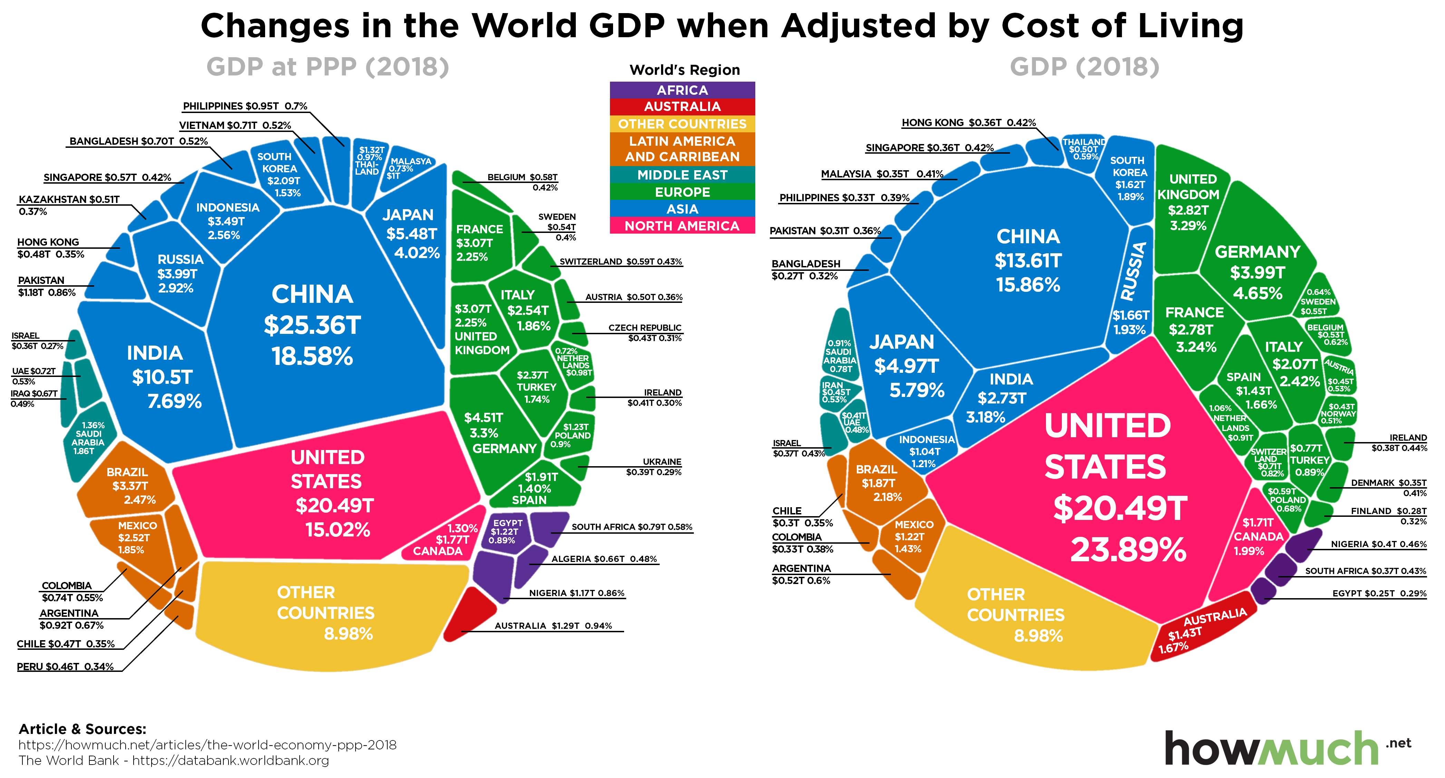
What We Talk About When We Talk About LatAm

Slide 6
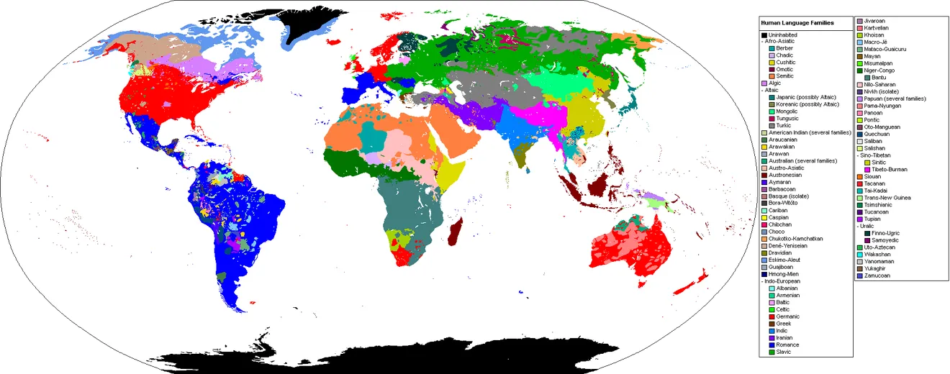
Is there such thing as Latin America?
1. The largest linguistic area with geographical contnuity?

Slide 7
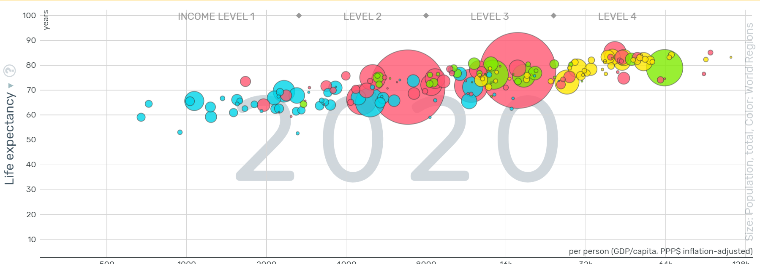
Is there such thing as Latin America?
2. Relatively homogenus per capita GDP
Or not?

Slide 8
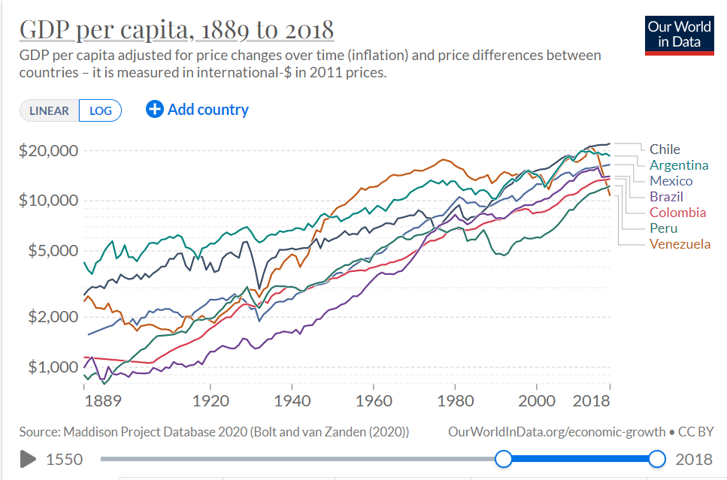
Is there such thing as Latin America?
2. Relatively homogenus per capita GDP... and converging regionally

Slide 9
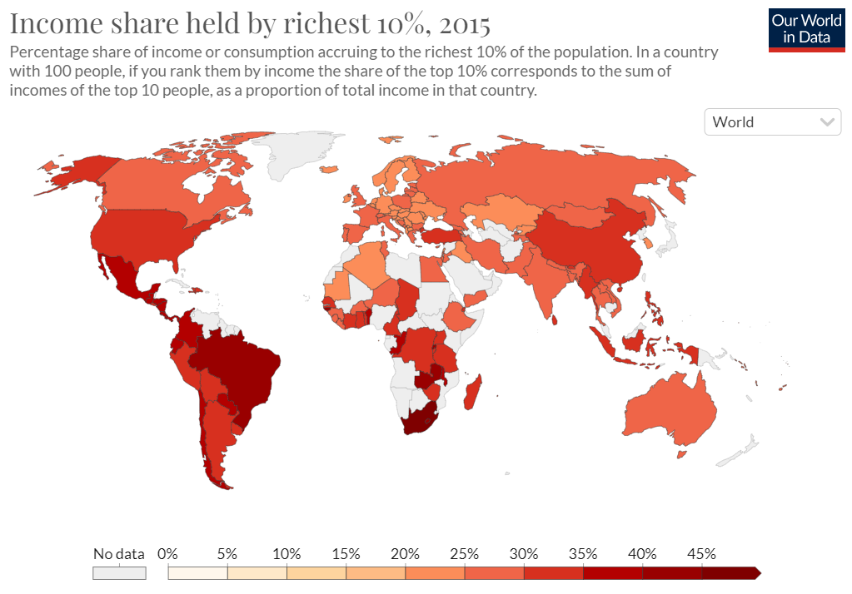
Is there such thing as Latin America?
3. Not all equally unequal, but all unequal

Slide 10
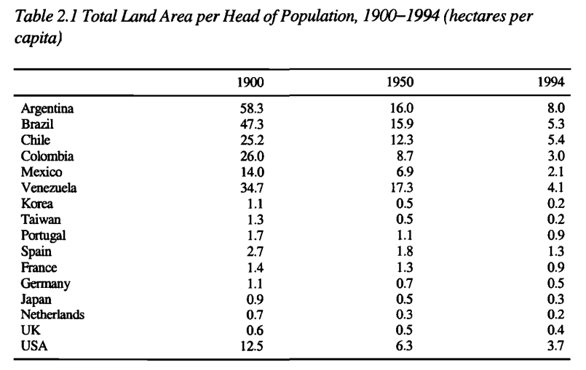
Is there such thing as Latin America?
4. In general, high land area per capita…
Source: Steckel paper in the reading list

Slide 11
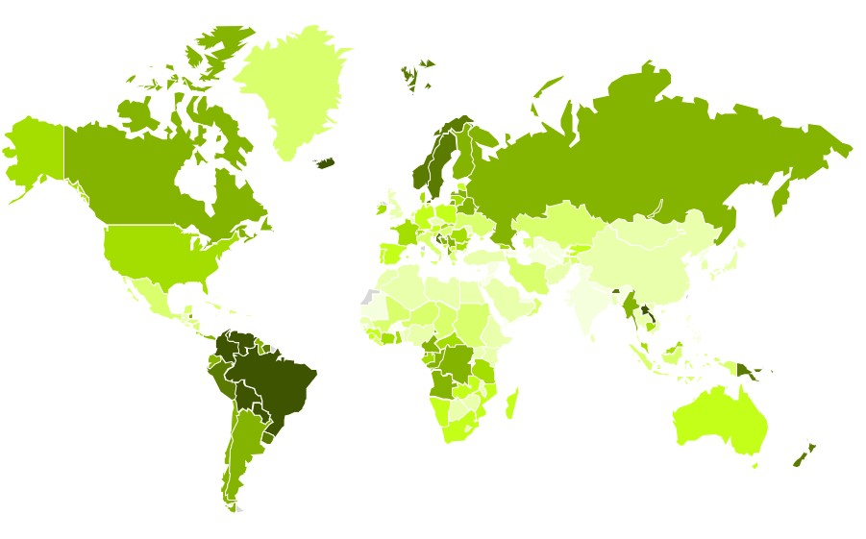
Is there such thing as Latin America?
4. …or natural resources per capita, and as a consequence...

Slide 12
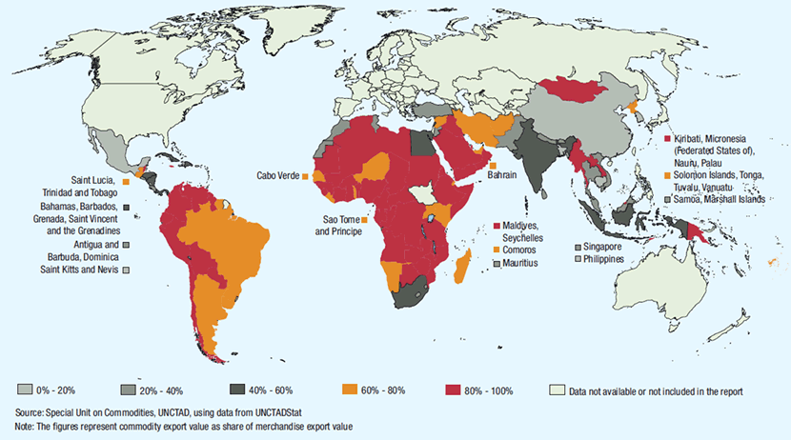
Is there such thing as Latin America?
5. High % of exports are primary products

Slide 13
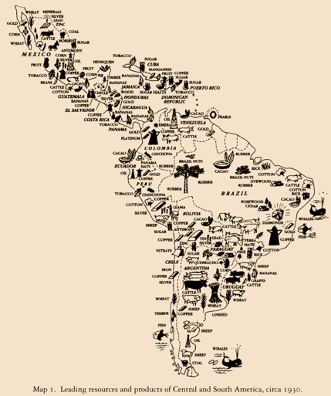
The Commodity Lottery
And a risky lottery...
From guano (Peru, overexploited) to oil (Venezuela, petro-populism) to wheat (Argentina, not enough income elasticity) to nitrates (Chile, replaced by German chemicals) to rubber (smuggled to South East Asia).

Slide 14
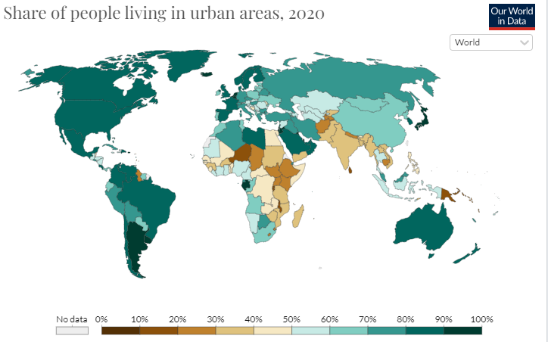
Is there such thing as Latin America?
6. Highly urbanized

Slide 15


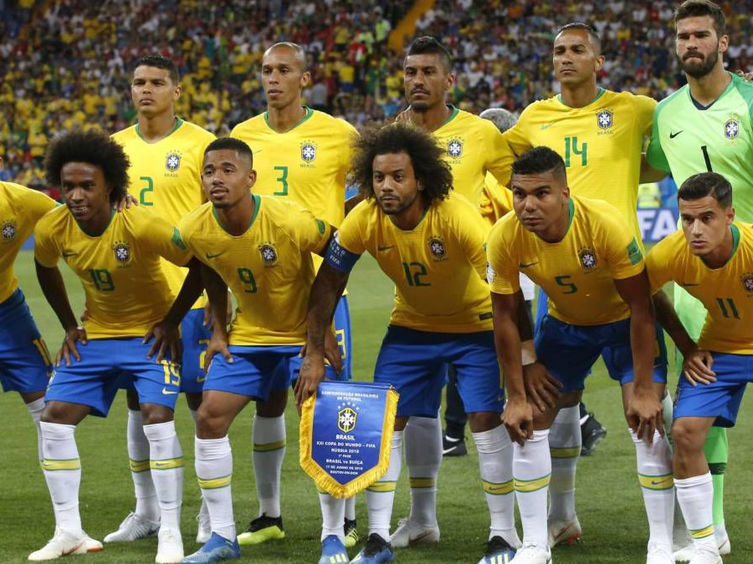
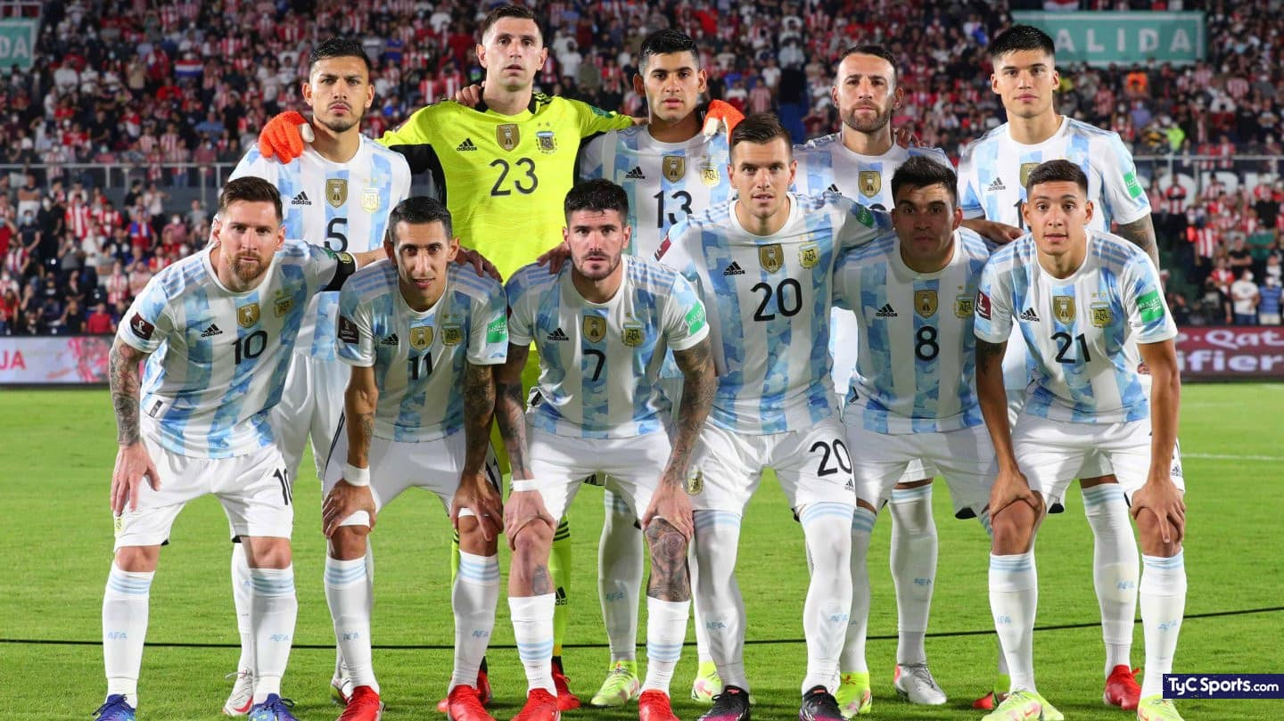
Is there such thing as Latin America?
7. Patterns of Migration and Ethnic Origins
Colombia
Mexico
Argentina
Brazil

Slide 16
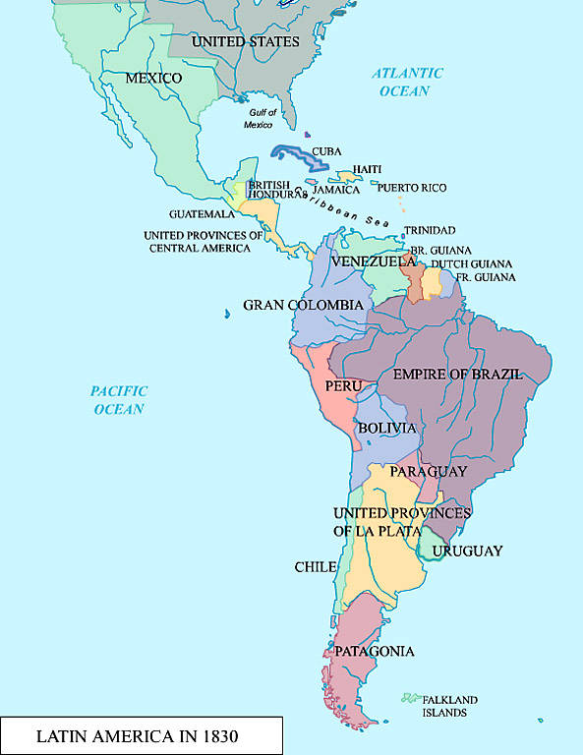
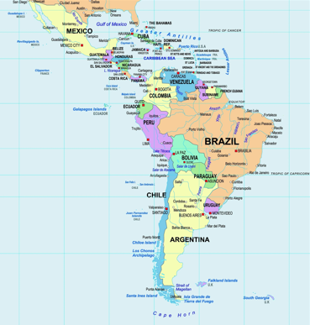
Is there such thing as Latin America?
8. Medium-term State stability
1830
2020

Slide 17
Is there such thing as Latin America?
9. Some degree of homogeneity in political institutions
No cases of complete institutional continuity such as the U.S.: a rather unstable institutional history.
No cases of long-term marxist systems apart from Cuba.
Normally a combination of oligarchic/democratic/semi-democratic republics and non-Marxist left or non-Fascsists right wing dictatorships.
Several cases of civil wars particulary in the 19th century.
No major wars between LatAm countries since the 19th century (some exceptions).
Mostly dictatorships in the 1970s replaced (mostly) by democracies since the 1980s, with varying degree of stability.

Slide 18
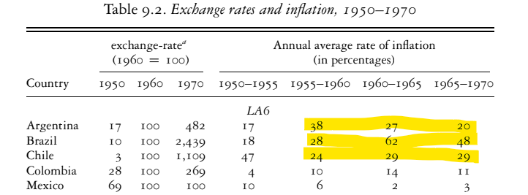
Is there such thing as Latin America?
10. History of macroeconomic instability

Slide 19
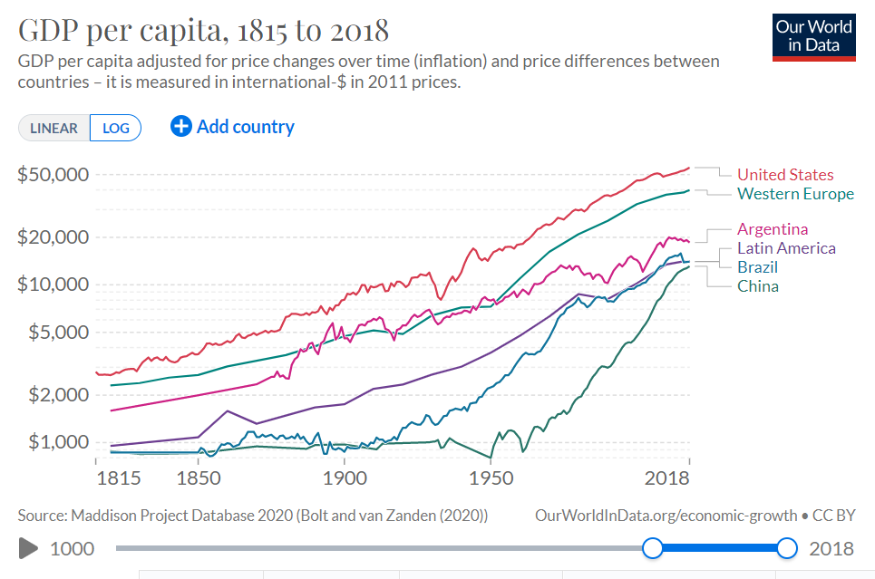
Dynamics in the Long Run: Convergence or Divergence?

Slide 20
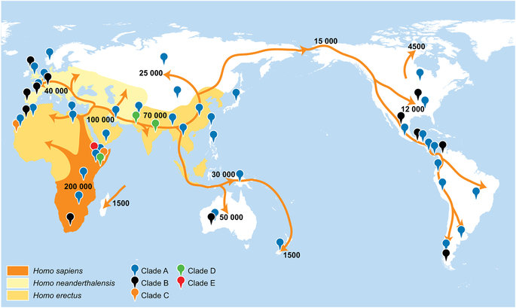
The PreHistory of LatAm and the Americas: A New (and Less Developed?) World

Slide 21
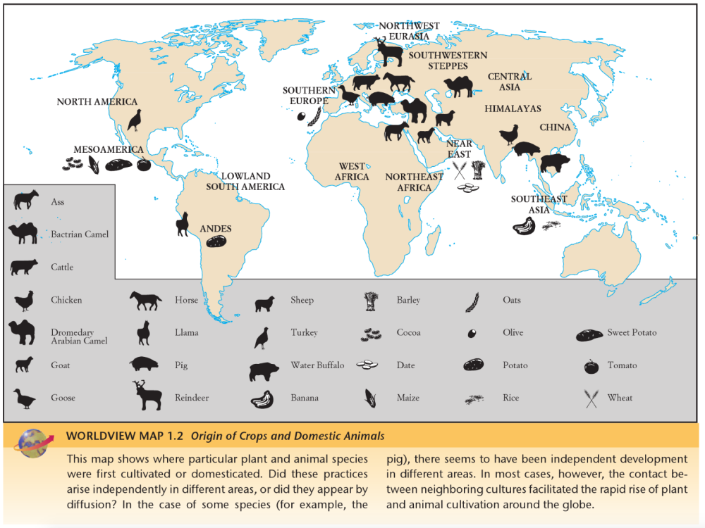
The PreHistory of LatAm and the Americas: the Diamond Hypothesis

Slide 22
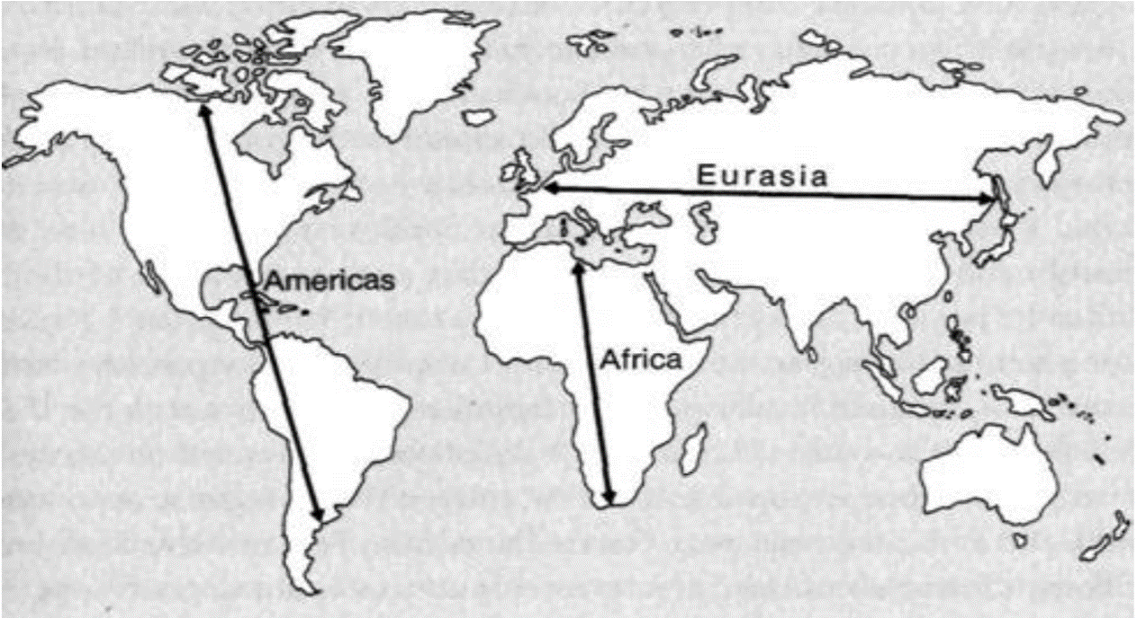
The PreHistory of LatAm and the Americas: the Diamond Hypothesis

Slide 23
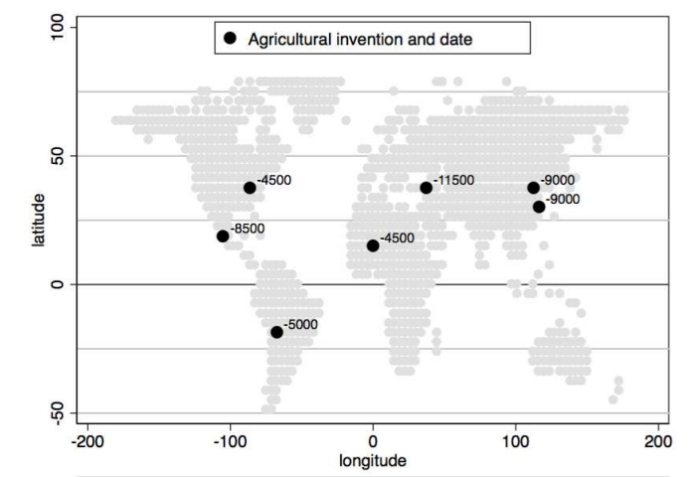
The PreHistory of LatAm: How "uncivilized"?
Source: Matranga (2017)

Slide 24
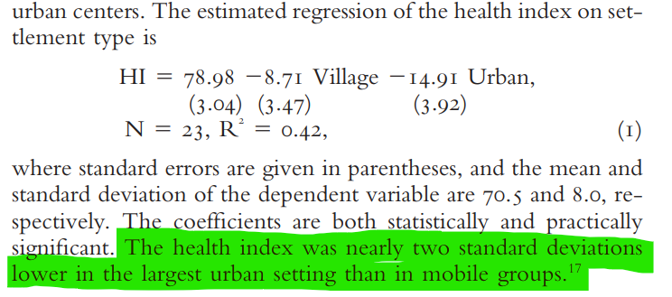
The PreHistory of LatAm: Welfare
Also Jared Diamond: "Agriculture, the Worst Mistake in Human History?"
Source: Steckel paper in the reading list

Slide 25
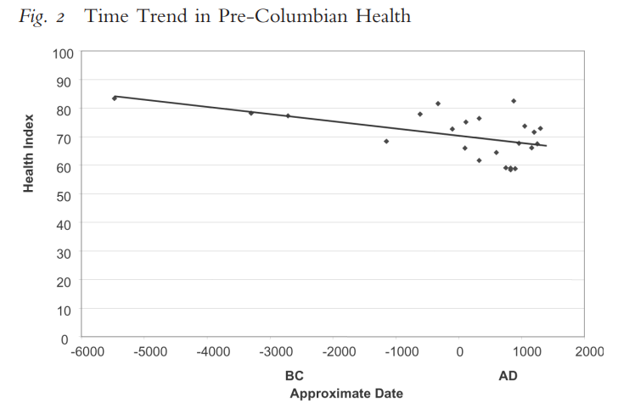
The PreHistory of LatAm: Welfare
Also Jared Diamond: "Agriculture, the Worst Mistake in Human History"

Slide 26
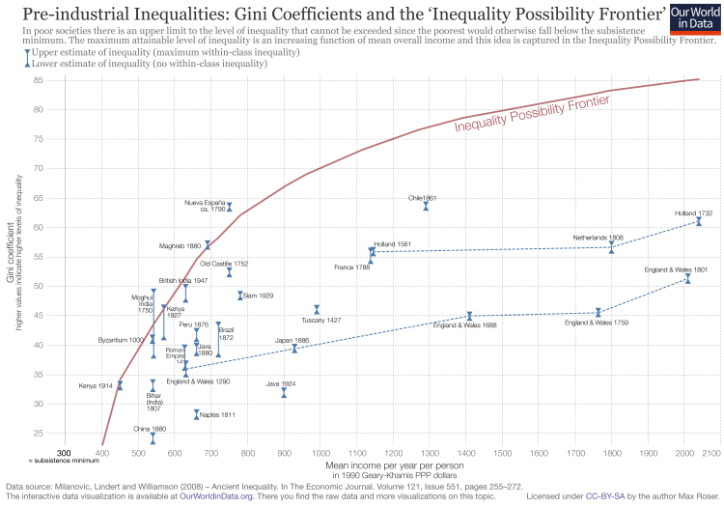
The PreHistory (and History) of LatAm: Inequality
The "inequality possibility frontier"

Slide 27
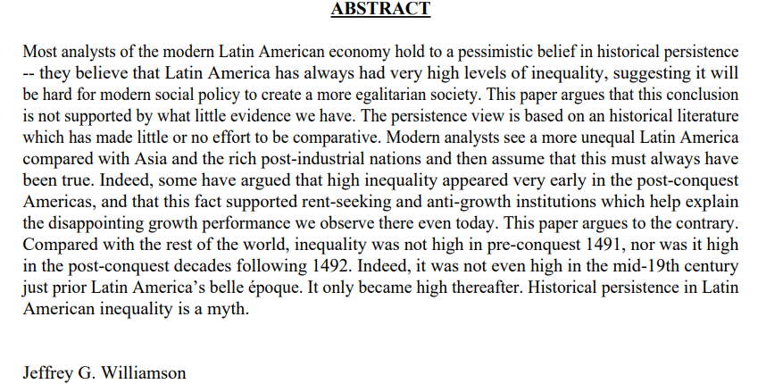
The PreHistory (and History) of LatAm: Inequality
The "inequality possibility frontier" and LatAm economic history (paper by Williamson)

Slide 28
Dynamics in the Economic History of LatAm: Shocks From Outside
Conquest (c. 1500)
Demographic collapse
A New Economic Hierachy
The Internationalization of the LatAm economy within the Iberian (Portuguese & Spanish) Empires
Independence (c. 1820)
Opening to international trade
National economic policies and the beginnings of macroeconomic instability (inflation, financial crises, defaults).

Slide 29
Dynamics in the Economic History of LatAm: Some Shocks From Outside
The effects of the Industrial Revolution
Demand, supply & specialization
The Transport Revolution, winners and super winners.
Deglobalisation (1914-1960s), Reglobalization (1970s and especially since 1990s) and the Ascent of the East.

Slide 30
Dynamics in the Economic History of LatAm: Inside Forces
Pro-global vs anti-global inside forces: the Sopler-Samuelson hypothesis and its relation to politics.
The costs of institutional weakness and instability.
Is inequality inefficent? The "extractive institution" hypothesis.
Distributional conflict in democratic and stagnant societies.

Slide 31
Our Lecture Series
(This lecture)
Colonial LatAm.
The effects of Independence.
"Export led growth"
World crises and its repercussions (1914-1950)
Inward-looking Industrialization
Macroeconomic crises of the late 20th century
LatAm present & prospects

